Slide 1
The Effects of AI
Craig Fields
&
Ben Smith

Slide 2
Title - project purposes and goals statements
Names - include all group member names, contact info, and project advisor
Project Abstract - carefully written statement of ~100 words, highlight key terms associated with project.
User Stories and Design Diagrams (Assignment #4)
Major Project Constraints (Assignment #7)

Slide 3
Project Abstract
In this project we will use the terms of AI and control to create a mobile application that helps restaurant owners keep track of their supplies. This app requires the use of user-input and variable control to design the system and make it keep track of the ingredients placed into the list. We want to try to use this to explain an example of the benefits Artificial Intelligence has on everyday life, and what better way to show that than with an ingredient tracker. We will utilize an AI’s Deep Learning in order for it to remember which ingredients are remaining within the container. We will also utilize several functions to make the system operate and perform the necessary techniques done to make the AI work and understand when a change in the ingredient list occurs. Plenty of coding and data designing will be required in this project. It will also take a lot of knowledge on online communications to mobile applications in order to get the project done.

Slide 4
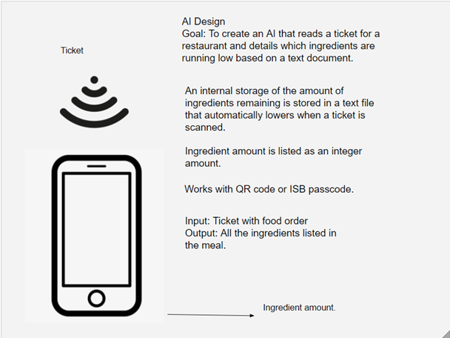
User Stories

Slide 5
Project Constraints
Economic costs: Can be restrained by a pricy software, also can be constrained by an imbalance in ingredient list.
Time: Due to some work I need to get caught up on, some assignments may take time for me to do successful completion.
Scope: One of my team members agree that this project will be hard enough to put in a considerable amount of time on, but easy enough to not overwhelm me or get into specifics that I don't know about.
Professional/Technical Expertise: It will require my expertise on computer programming and AI development in order to get completed. I may require more time for me to finish the whole project due to my lack of practice with this type of program and may require me to get more group members involved.
Ethical/Legal: It will help restaurants specifically keep track of their ingredients and detail when they need to order more. No copyrighted characters or music are involved, so no legal disputes are involved.
Security: Could result in the txt file being hacked by hackers to offset the amount of ingredients remaining.
Social: This is an app primarily used by restaurants by staff members, not much for public use. It will benefit lives by helping keep track of restaurant supplies.
Environmental: As far as I'm aware, all environmental issues that phone apps usually contain will also apply to the project due to also being a phone app. It will also exclusively be used in restaurants.

Slide 6
Review of Project Progress
Major Milestones Thus Far…
Scope, concept, and execution of project finalized
Concept drawing and early designs for hardware
What’s Happening Now?
Working on full parts list for hardware components
Designing a 3D printed housing for the prototype.

Slide 7
Expected Accomplishments (Fall 2020)
Working prototype of the hardware to prove feasibility
Working V1.0 of the related software/App
Concept UI
Demo connectivity between hardware and software

Slide 8
Division of Work
Milestones Completion Goal Maxim of Effort
Hardware schematics finalized October 20 C: 33% B: 33% L: 33%
3D printed housing designed and finalized October 31 C: 20% B: 60% L: 20%
Working prototype of software portion of project November 20 C: 33% B: 33% L: 33%
Successfully talk between hardware and software November 30 C: 60% B: 20% L: 20%
Working prototype of full project December 14 C: 33% B: 33% L: 33%

Slide 9
Expected Demo at Expo
A presentation board with use cases and why a business would benefit from this product/project
Working prototype at the Expo
User/Customer interaction with prototype
Allow some users/customers to download v1.0 of app

